Slide 1
HNDIT1012 Visual Application Programming
Week 9

Slide 2
FileDialog Class
Displays a dialog box from which the user can select a file. Some properties of FileDialog are:
CheckFileExists | Gets or sets a value indicating whether the dialog box displays a warning if the user specifies a file name that does not exist.
CheckPathExists | Gets or sets a value indicating whether the dialog box displays a warning if the user specifies a path that does not exist.
FileName | Gets or sets a string containing the file name selected in the file dialog box.
FileNames | Gets the file names of all selected files in the dialog box.
Filter | Gets or sets the current file name filter string, which determines the choices that appear in the "Save as file type" or "Files of type" box in the dialog box.
FilterIndex | Gets or sets the index of the filter currently selected in the file dialog box.
InitialDirectory | Gets or sets the initial directory displayed by the file dialog box.

Slide 3
System.IO.File Class
Provides static methods for the
creation,
copying,
deletion,
moving, and
opening of a single file

Slide 4
Some Methods of File Class
ReadAllText(fileName) - Opens a text file, reads all the text in the file, and then closes the file.
ReadAllLines(fileName) - Opens a text file, reads all lines of the file, and then closes the file.
ReadAllBytes(fileName) - Opens a binary file, reads the contents of the file into a byte array, and then closes the file.
WriteAllText(fileName, textContent) - Creates a new file, writes the specified string to the file, and then closes the file. If the target file already exists, it is overwritten.

Slide 5
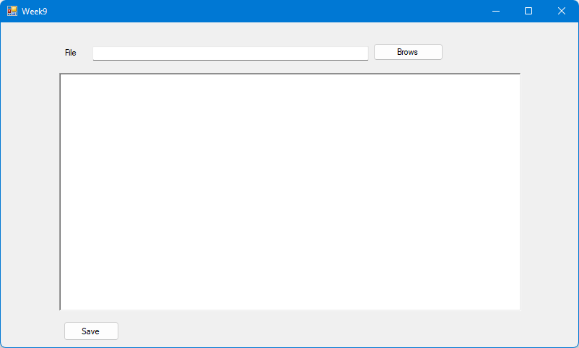
Example- Design a form as shown below

Slide 6
Reading all contents of a text file
private void btnBrows_Click(object sender, EventArgs e)
{
OpenFileDialog fileDialog = new OpenFileDialog();
fileDialog.Filter = "txt files (*.txt)|*.txt|All files (*.*)|*.*";
fileDialog.FilterIndex = 0;
fileDialog.InitialDirectory = @“C:\asp c#"; // give your default directory
// Reading all contents of a text file
if (fileDialog.ShowDialog() == DialogResult.OK)
{
txtFile.Text = fileDialog.FileName;
string readBuffer = System.IO.File.ReadAllText(fileDialog.FileName);
richTextBox1.Text=readBuffer;
}
}

Slide 7
Reading a text file line by line
private void btnBrows_Click(object sender, EventArgs e)
{
OpenFileDialog fileDialog = new OpenFileDialog();
fileDialog.Filter = "txt files (*.txt)|*.txt|All files (*.*)|*.*";
fileDialog.FilterIndex = 0;
fileDialog.InitialDirectory = @"E:\asp c#"; // give your default directory
// Reading a text file line by line
if (fileDialog.ShowDialog() == DialogResult.OK)
{
txtFile.Text = fileDialog.FileName;
string[] readBuffer = System.IO.File.ReadAllLines(fileDialog.FileName);
for (int i = 0; i < readBuffer.Length; i++)
richTextBox1.Text = readBuffer[i] +"\n";
}
}

Slide 8
Reading a file byte by byte
private void btnBrows_Click(object sender, EventArgs e)
{
OpenFileDialog fileDialog = new OpenFileDialog();
fileDialog.Filter = "txt files (*.txt)|*.txt|All files (*.*)|*.*";
fileDialog.FilterIndex = 0;
fileDialog.InitialDirectory = @"E:\asp c#";
// Reading a file byte by byte
if (fileDialog.ShowDialog() == DialogResult.OK)
{
txtFile.Text = fileDialog.FileName;
byte[] readBuffer = System.IO.File.ReadAllBytes(fileDialog.FileName);
foreach (byte b in readBuffer)
richTextBox1.Text += (char)b;
}
}

Slide 9
Saving a text File
Type the following code to the save button click event.
private void btnSave_Click(object sender, EventArgs e)
{
SaveFileDialog fileDialog = new SaveFileDialog();
fileDialog.InitialDirectory = @"C:\Users\garig";
fileDialog.Filter = "txt files (*.txt)|*.txt|All files (*.*)|*.*";
//add default extension if the user omit extension
fileDialog.AddExtension = true;
fileDialog.DefaultExt = ".txt"; //default extension
if (fileDialog.ShowDialog() == DialogResult.OK)
{
System.IO.File.WriteAllText(fileDialog.FileName,richTextBox1.Text);
}
}

Slide 10
Thank You

